Slide 1
Shared Access Networks
Outline
  Bus (Ethernet)
  Token ring (FDDI)
  Wireless (802.11)

Slide 2
Ethernet Overview
History
  developed by Xerox PARC in mid-1970s
  roots in Aloha packet-radio network
  standardized by Xerox, DEC, and Intel in 1978
  similar to IEEE 802.3 standard
CSMA/CD
  carrier sense
  multiple access
  collision detection
Frame Format
64
48
48
16
32
Preamble
Dest
Src
Type
Body
CRC
addr
addr

Slide 3
Ethernet (cont)
Addresses
  unique, 48-bit unicast address assigned to each adapter
  example: 8:0:e4:b1:2
  broadcast: all 1s
  multicast: first bit is 1
Bandwidth: 10Mbps, 100Mbps, 1Gbps
Length: 2500m (500m segments with 4 repeaters)
Problem: Distributed algorithm that provides fair access

Slide 4
Transmit Algorithm
If line is idle…
  send immediately
  upper bound message size of 1500 bytes
  must wait 9.6us between back-to-back frames
If line is busy…
  wait until idle and transmit immediately
  called 1-persistent (special case of p-persistent)

Slide 5
Algorithm (cont)
If collision…
  jam for 32 bits, then stop transmitting frame
  minimum frame is 64 bytes (header + 46 bytes of data)
  delay and try again
    1st time: 0 or 51.2us
    2nd time: 0, 51.2, or 102.4us
    3rd time51.2, 102.4, or 153.6us
    nth time: k x 51.2us, for randomly selected k=0..2^{n} - 1
    give up after several tries (usually 16)
    exponential backoff

Slide 6
Collisions
A
B
A
B
A
B
A
B

Slide 7
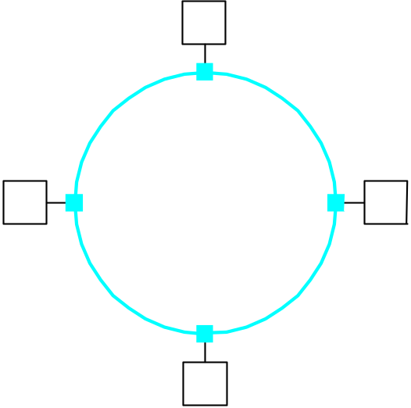
Token Ring Overview
Examples
  16Mbps IEEE 802.5 (based on earlier IBM ring)
  100Mbps Fiber Distributed Data Interface (FDDI)

Slide 8
Token Ring (cont)
Idea
  Frames flow in one direction: upstream to downstream
  special bit pattern (token) rotates around ring
  must capture token before transmitting
  release token after done transmitting
    immediate release
    delayed release
  remove your frame when it comes back around
  stations get round-robin service
Frame Format
8
8
48
48
32
8
24
Start of
Control
Dest
Src
Body
CRC
End of
Status
frame
addr
addr
frame

Slide 9
Timed Token Algorithm
Token Holding Time (THT)
  upper limit on how long a station can hold the token
Token Rotation Time (TRT)
  how long it takes the token to traverse the ring.
  TRT <= ActiveNodes x THT + RingLatency
Target Token Rotation Time (TTRT)
  agreed-upon upper bound on TRT

Slide 10
Algorithm (cont)
Each node measures TRT between successive tokens
  if measured-TRT > TTRT: token is late so don’t send
  if measured-TRT < TTRT: token is early so OK to send
Two classes of traffic
  synchronous: can always send
  asynchronous: can send only if token is early
Worse case: 2xTTRT between seeing token
Back-to-back 2xTTRT rotations not possible

Slide 11
Token Maintenance
Lost Token
  no token when initializing ring
  bit error corrupts token pattern
  node holding token crashes
Generating a Token (and agreeing on TTRT)
  execute when join ring or suspect a failure
  send a claim frame that includes the node’s TTRT bid
  when receive claim frame, update the bid and forward
  if your claim frame makes it all the way around the ring:
    your bid was the lowest
    everyone knows TTRT
    you insert new token

Slide 12
Maintenance (cont)
Monitoring for a Valid Token
  should periodically see valid transmission (frame or token)
  maximum gap = ring latency + max frame < = 2.5ms
  set timer at 2.5ms and send claim frame if it fires

Slide 13
Wireless LANs
IEEE 802.11
Bandwidth: 1 or 2 Mbps
Physical Media
  spread spectrum radio (2.4GHz)
  diffused infrared (10m)

Slide 14
Spread Spectrum
Idea
  spread signal over wider frequency band than required
  originally deigned to thwart jamming
Frequency Hopping
  transmit over random sequence of frequencies
  sender and receiver share…
    pseudorandom number generator
    seed
  802.11 uses 79 x 1MHz-wide frequency bands

Slide 15
Spread Spectrum (cont)
Direct Sequence
  for each bit, send XOR of that bit and n random bits
  random sequence known to both sender and receiver
  called n-bit chipping code
  802.11 defines an 11-bit chipping code
1
0
Data stream: 1010
1
0
Random sequence: 0100101101011001
1
0
XOR of the two: 1011101110101001

Slide 16
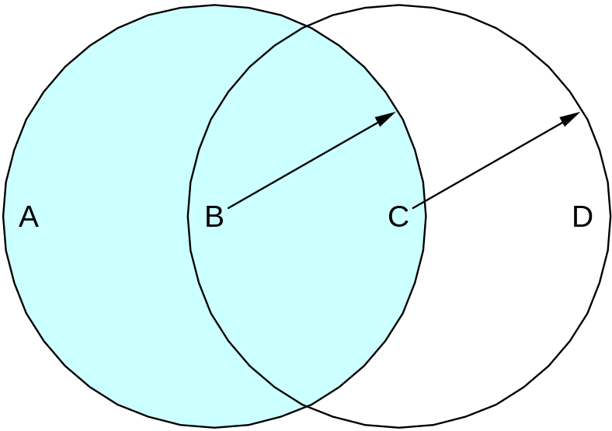
Collisions Avoidance
Similar to Ethernet
Problem: hidden and exposed nodes

Slide 17
MACAW
Sender transmits RequestToSend (RTS) frame
Receiver replies with ClearToSend (CTS) frame
Neighbors…
  see CTS: keep quiet
  see RTS but not CTS: ok to transmit
Receive sends ACK when has frame
  neighbors silent until see ACK
Collisions
  no collisions detection
  known when don’t receive CTS
  exponential backoff

Slide 18
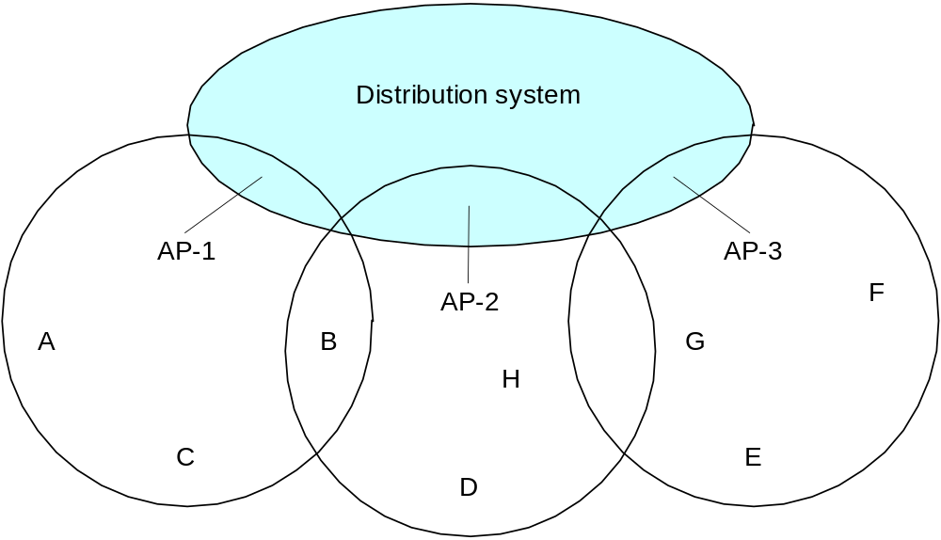
Supporting Mobility
Case 1: ad hoc net working
Case 2: access points (AP)
  tethered
  each mobile node associates with an AP

Slide 19
Mobility (cont)
Scanning (selecting an AP)
  node sends Probe frame
  all AP’s w/in reach reply with ProbeResponse frame
  node selects one AP; sends it AssociateRequest frame
  AP replies with AssociationResponse frame
  new AP informs old AP via tethered network
When
  active: when join or move
  passive: AP periodically sends Beacon frame

